Slide 1
Cmple++
A cross-platform C++ code generator/preprocessor.
By Anton Dospekhov & Igor Parfenov

Slide 2
ABOUT C++ Development
Developing a complex graphical C++ project often happens to be frustrating due to amount of boilerplate code a programmer has to write.
The utilization of graphical capabilities requires from you extensive knowledge about GPU API or libraries that operate it.

Slide 3
PROBLEM
boilerplate
Graphical pipeline
You can spend whole day trying to set up a simple “Hello world” system
Modern Graphical APIs require full understanding of rendering pipeline & resource management
Complex OOP system
No sandbox
Developer has to use all capabilities of OOP to setup relations between components
To work in simplified environment you need to build it yourself
HIGH ENTRY LEVEL
Complicated workflow stops beginner game developers from learning game engine architecture

Slide 4
SOLUTION
AUTO referencing
API calls elision
Signatures and definitions are automatically linked, modules are automatically imported, if used
Narrowed set of commands allows beginner to learn minimum new functions
EASY TO USE
MEMORY Management
Simplified syntax requirement allows programmers to write the code they have to
Automatic resource allocation, distribution, relocation, optimization, defragmentation and release

Slide 5
PRODUCT OVERVIEW
Preprocessor
PROJECT SCOPE
Our tool runs on source code files before compilation and fills all necessary information
All project files are processed at once, that allows components resolution on global level
Memory injector
Library dependency
All memory operations are performed through special resource management system to avoid leaks and corruption
The project comes with set of essential and commonly accepted third-party tools and libraries that are imported when needed

Slide 6
PRODUCT BENEFITS
User can write light and “Cmple” code
No thinking about function declaration & definition matching
No thinking about header inclusion and guards
No thinking about libraries depenedcies
No thinking about access protection system
No thinking about memory issues
It is not a new language, it’s same, but “Cmple”!

Slide 7
Converter OVERVIEW

Slide 8
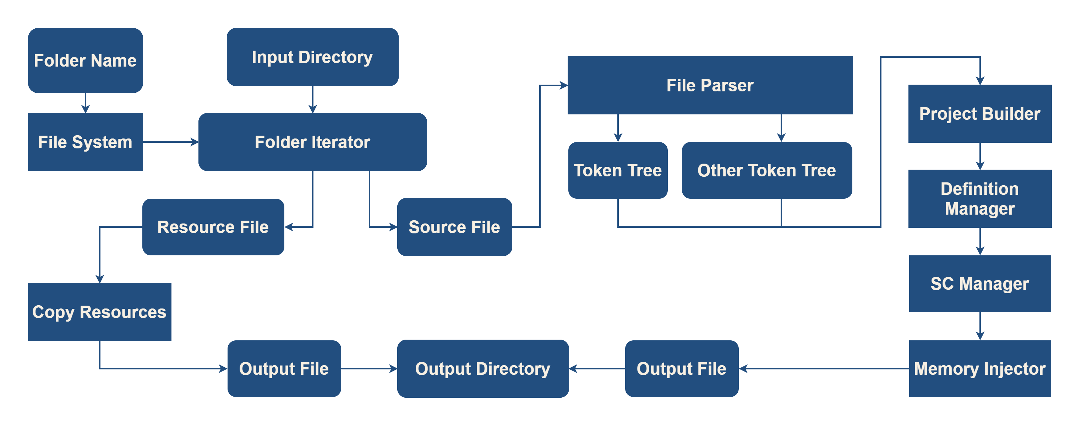
Logic view

Slide 9
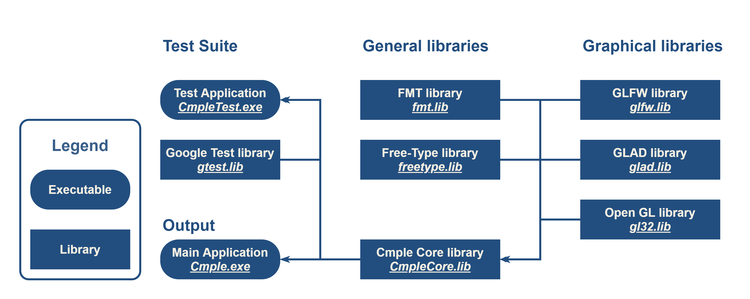
Physical View

Slide 10
UML diagram

Slide 11
Runtime overview

Slide 12
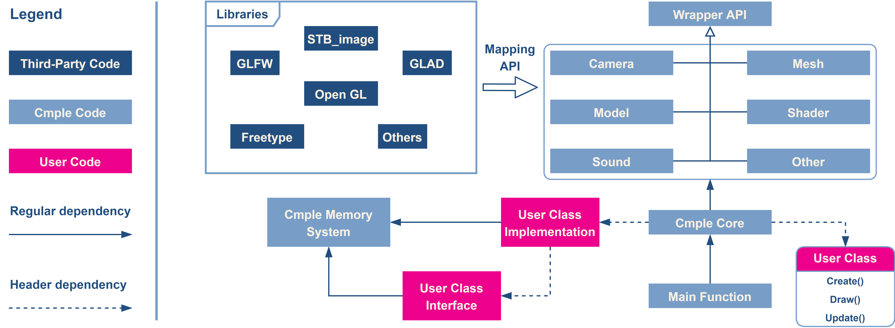
Runtime overview

Slide 13

SUMMARY
Cmple tool is a quality of life tool. By using our code generator, we help beginner programmers to enter into world of graphical applications. It is essential for enthusiasts that want their own playground for experiments. As George Corrette said, "First learn computer science and all the theory. Next develop a programming style. Then forget all that and just write code."

Slide 14
THANK YOU
Anton Dospekhov
Igor Parfenov
a.dospekhov@innopolis.university
i.parfenov@innopolis.university

